Slide 1

Team Name : Team AI Innovators
Team Leader Name : Shrinivas Hunnur
Problem Statement : AI-Powered Governance Platform (Maharashtra State Government) #10

Slide 2
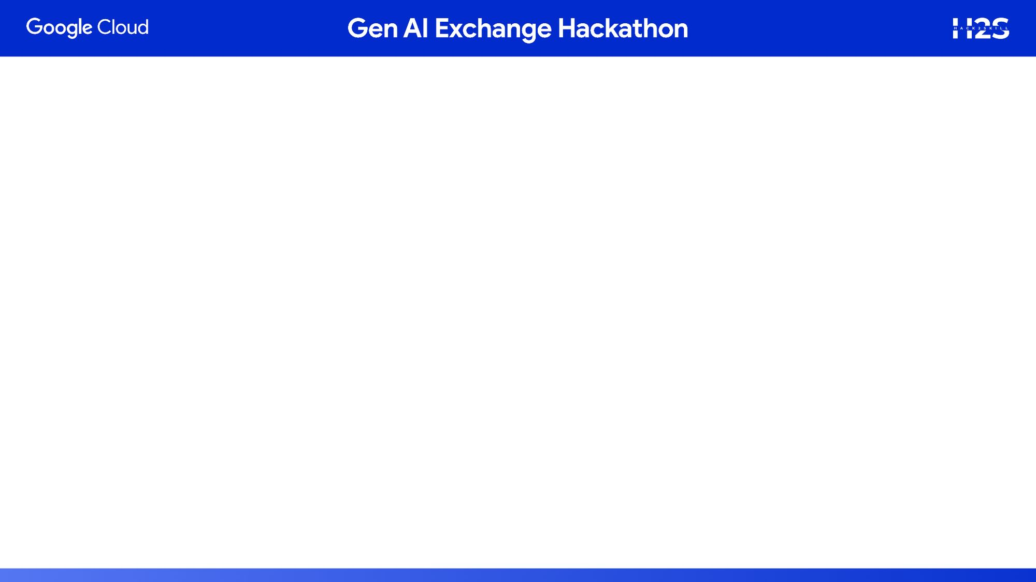
Challenges:
Vast multi-sectoral datasets (health, infrastructure, safety)
- Siloed and underutilized for decision-making
- Reactive processes → Delayed service delivery
- Lack of predictability
- Inefficient resource allocation

Slide 3
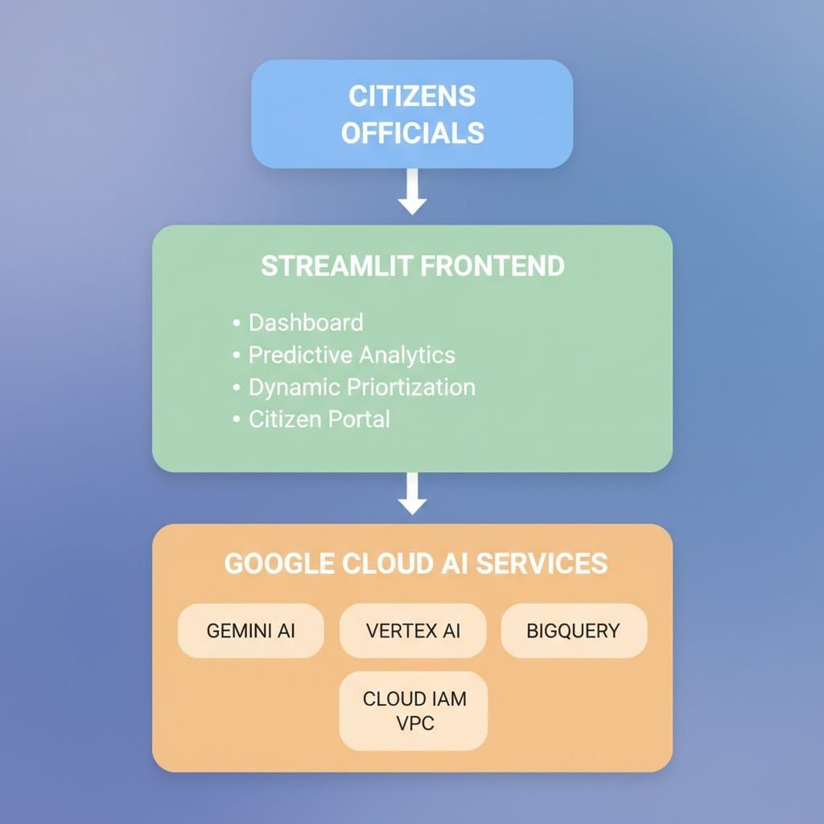
Technical Architecture:

Slide 4
Core Features:
Predictive AI Models : a) 7-day demand forecasting b) Bottleneck identification c) Risk anticipation
Dynamic Prioritization : a) Automatic priority scoring b) Smart routing c)Real-time triage
Privacy & Security : a)AES-256 encryption b) Data anonymization c) Complete audit trail
Decision Dashboards : a) Real-time analytics b) Visual insights c) Actionable recommendations
GaaS Transparency : a) Public data access b) Trust metrics c) Measurable impact

Slide 5
Tech Stack Compliance :
✅ Google Gemini AI - NLP & Predictions
✅ Vertex AI - ML Model Deployment
✅ BigQuery - Data Warehousing
✅ Cloud IAM/VPC - Security & Compliance100% Compliance with Problem Statement

Slide 6
Our Solution:
AI-Driven Governance Platform:
Transforms raw data into predictive intelligence.
Key Innovation:
Proactive governance through AI predictions

Slide 7
Key Metrics:
Performance:
Query Response: <500ms
AI Accuracy: 94%
Data Records: 120+
Resolution Improvement: 60%
Security:
Encryption: AES-256
Privacy: 100% anonymized
Compliance: ISO 27001, GDPR

Slide 8
Impact & Benefits :
For Citizens:
✓ Faster resolution (60% improvement)
✓ Transparent tracking
✓ Data privacy guaranteed
For Government:
✓ Predictive insights
✓ Optimized resources
✓ Data-driven decisions
For Society:
✓ Proactive governance
✓ Trust through transparency
✓ Measurable outcomes

Slide 9
Future Roadmap :
Phase 2 (Next 6 months):
Mobile app for citizens
WhatsApp bot integration
Multi-language support (Marathi, Hindi)
Integration with 50+ departments
Scale to 1M+ records
Phase 3:
Predictive maintenance for infrastructure
Real-time crisis management
Cross-state data sharing

Slide 10


